Slide 1
Mechanical Operation
B.Tech, 3rd Semester
Chemical Engineering
Kashinath Barik
Asst. Professor
Dept. of Chemical Engg.
IGIT Sarang

Slide 2
Contents:
Syllabus
Mark Distribution
Introduction
Module-I
Assignment-I
Exam-I
Module-II
Assignment-II
Exam-II
Module-III
Assignment-III
Semester Exam

Slide 7
Martin (1931) defined the size of an irregular particle as the length of the line bisecting the maximum cross-sectional area of the particle.
2. Feret (1929) defined the particle size as the distance between two most extreme points on the particle surface.
The limitations of such definitions are obvious as unable to give actual size or shape of an irregular particle.
Later years,
1. Particles size are defined by comparing with a standard configuration ( normally with a spherical particle), which called equivalent size or equivalent diameter.
So, equivalent diameter of an irregular particle can be defined as the size of a spherical particle having the same controlling characteristics as the particle under consideration.
2. After size defined , shape comes to picture. One method to define the shape is sphericity.
It is defined as the ratio of the surface area of a spherical particle having the same volume as the particle to the surface area of particle.

Slide 12
Determination of Particle Size or the size distribution of a mixture of particle.
Screening (above 40 microns)
Gravity sedimentation (1-100 microns)
Centrifugal sedimentation (0.005-3 microns)
Elutriation under gravity (5-100 microns)
Centrifugal field (1-60 microns)
Ultra microscope (0.005-0.2 microns)
Light scattering (0.1-10 microns)
X-ray scattering (0.005-0.05 microns)

Slide 13
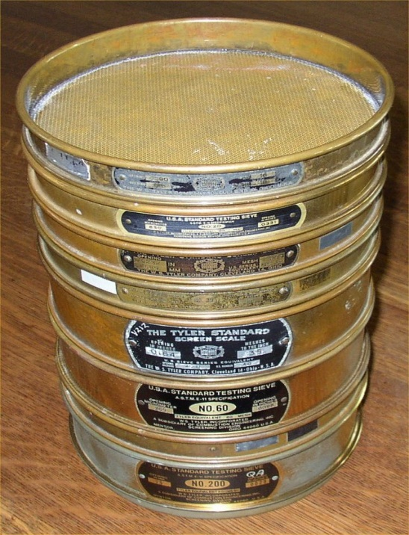
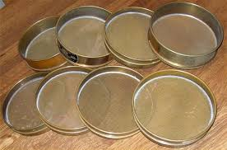
Screening
Screen: An open container usually cylindrical with uniformly spaced
openings at the base. The size of the square opening (the length
of clear space between individual wires) is called aperture size of the
screen.
Example: A screen having 10 square opening per cm may be called 10 mesh screen
and aperture size of the screen will be 0.1 cm minus the wire diameter. Higher the
mesh screen, smaller will be the aperture size of the screen. This is British standard
screen(BSS). Similarly ASTM (American standard screen), Tyler standard screen,
German standard screen (DNN 1171), and Indian standard screens (ISS) are available.

Slide 14
For Tyler standard screen sizes, the area of the openings in any one screen
in the series is exactly twice that of the openings in the next-smaller screen.
The ratio of actual mesh dimension of any screen to that of the next-smaller
screen is
The screen analysis done nearly for 20 minutes and the results are tabulated to find
mass fraction and average diameter of particle.
Two numbers are needed to specify the size range of an increment.
Example: 14/20 (pass through 14 mesh and retained on 20 mesh)
ISS of mesh number is equal to its aperture size expressed to the nearest
deca-micron (0.01 mm), so Is screen of 50 mesh will have an aperture width of
Approximately 500 microns
-480+400 (- sign for material passes through or under size and + sign for retained
material or the over size.
Average size (d_{avg}) of the particle in this fraction will be arithmetic average of
Aperture size of this two screens, and the mass fraction (x) will be mass retained on
lower screen divided by total mass. This method of size distribution presentation is
called differential size analysis.
Gaudin-Schumann Size distribution:

